Slide 1



Module 1.2 (A)
Autonomous Robots: Robot or Not
Living and Working with Artificial Intelligence
Adapted from the Robot or Not Activity developed by MIT for the AI4GA (Artificial Intelligence for Georgia) project funded by National Science Foundation awards DRL-2049029 and DRL-2048502.
This work is licensed under the Creative Commons. Attribution-NonComercial-ShareAlike 4.0 International License. https://creativecommons.org/licenses/by-nc-sa/4.0/

Slide 2
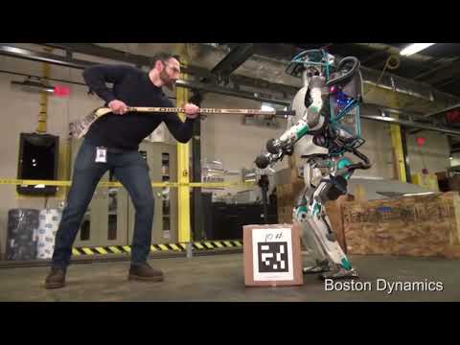
What was interesting about the robots?
What kinds of things are the robots doing?
Are these robots being remote controlled?
Notes:
🍐 This is a Pear Deck Text Slide
🍐 To edit the type of question, go back to the "Ask Students a Question" in the Pear Deck sidebar.
This video is an exciting look at autonomous robot.
Questions to ponder:
What was interesting about the robots?
What kinds of things are the robots doing?
Are these robots being remote controlled?
We will learn more about this today :)

Slide 3
EQs
How are autonomous robots different from other machines/software?
Where can we find autonomous robots working?
How can we differentiate between high, medium, and low levels of autonomy in robots?

Slide 4
Activity 1
Is it a robot or not?

Slide 5
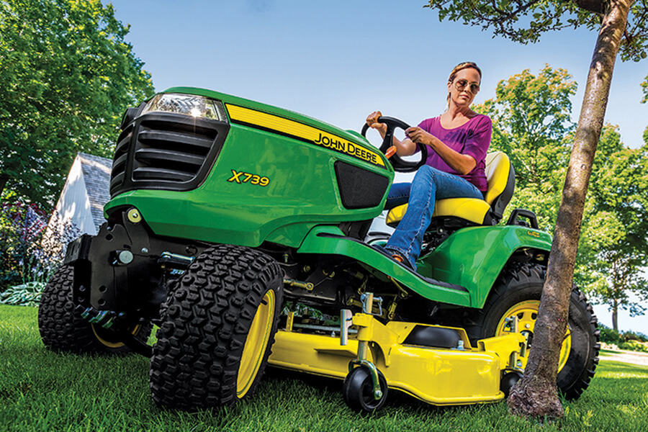
Robot or Not? Riding Lawn Mower
Notes:
🍐 This is a Pear Deck Multiple Choice Slide. Your current options are: A: YES, B: NO,
🍐 To edit the type of question or choices, go back to the "Ask Students a Question" in the Pear Deck sidebar.

Slide 6
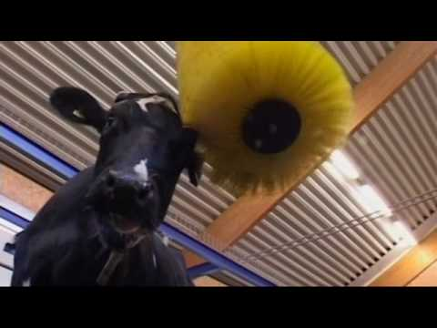
Robot or Not? Cowbrush
Notes:
🍐 This is a Pear Deck Multiple Choice Slide. Your current options are: A: YES, B: NO,
🍐 To edit the type of question or choices, go back to the "Ask Students a Question" in the Pear Deck sidebar.

Slide 7

Robot or Not? Laptop
Notes:
🍐 This is a Pear Deck Multiple Choice Slide. Your current options are: A: YES, B: NO,
🍐 To edit the type of question or choices, go back to the "Ask Students a Question" in the Pear Deck sidebar.

Slide 8
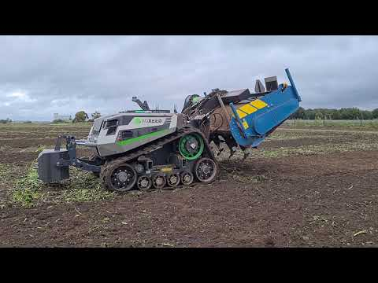
Robot or Not?
Self-Driving Tractor
Notes:
🍐 This is a Pear Deck Multiple Choice Slide. Your current options are: A: YES, B: NO,
🍐 To edit the type of question or choices, go back to the "Ask Students a Question" in the Pear Deck sidebar.

Slide 9
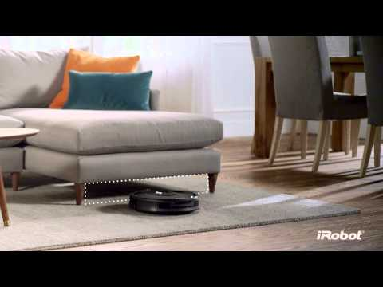
Robot or Not?
Roomba Vaccum
Notes:
🍐 This is a Pear Deck Multiple Choice Slide. Your current options are: A: YES, B: NO,
🍐 To edit the type of question or choices, go back to the "Ask Students a Question" in the Pear Deck sidebar.

Slide 10
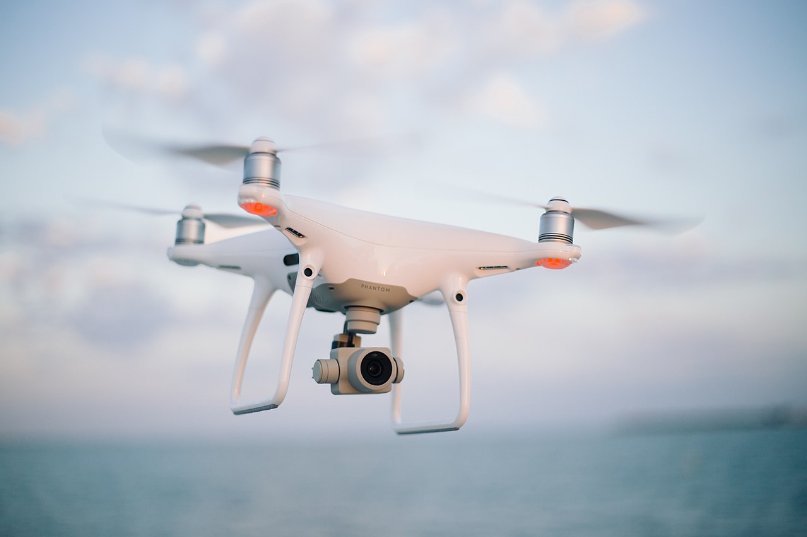
Robot or Not?
Drone
Notes:
🍐 This is a Pear Deck Multiple Choice Slide. Your current options are: A: YES, B: NO,
🍐 To edit the type of question or choices, go back to the "Ask Students a Question" in the Pear Deck sidebar.

Slide 11

Robot or Not?
Tablet
Notes:
🍐 This is a Pear Deck Multiple Choice Slide. Your current options are: A: YES, B: NO,
🍐 To edit the type of question or choices, go back to the "Ask Students a Question" in the Pear Deck sidebar.

Slide 12
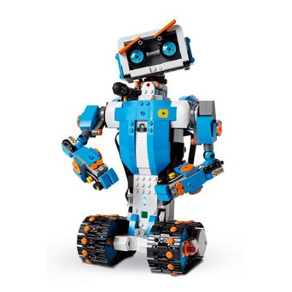
Robot or Not? Toy Robot
Notes:
🍐 This is a Pear Deck Multiple Choice Slide. Your current options are: A: YES, B: NO,
🍐 To edit the type of question or choices, go back to the "Ask Students a Question" in the Pear Deck sidebar.

Slide 13
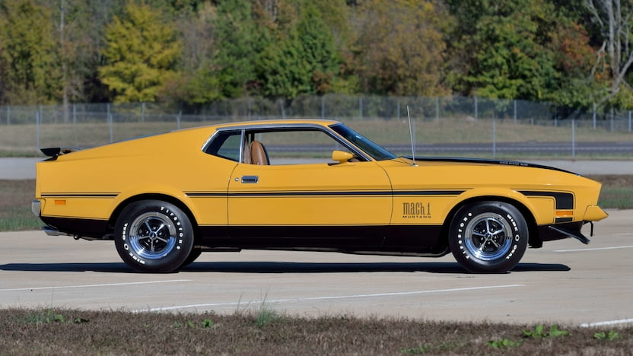
Robot or Not?
1970
Ford
Mustang Mach 1
Notes:
🍐 This is a Pear Deck Multiple Choice Slide. Your current options are: A: YES, B: NO,
🍐 To edit the type of question or choices, go back to the "Ask Students a Question" in the Pear Deck sidebar.

Slide 14
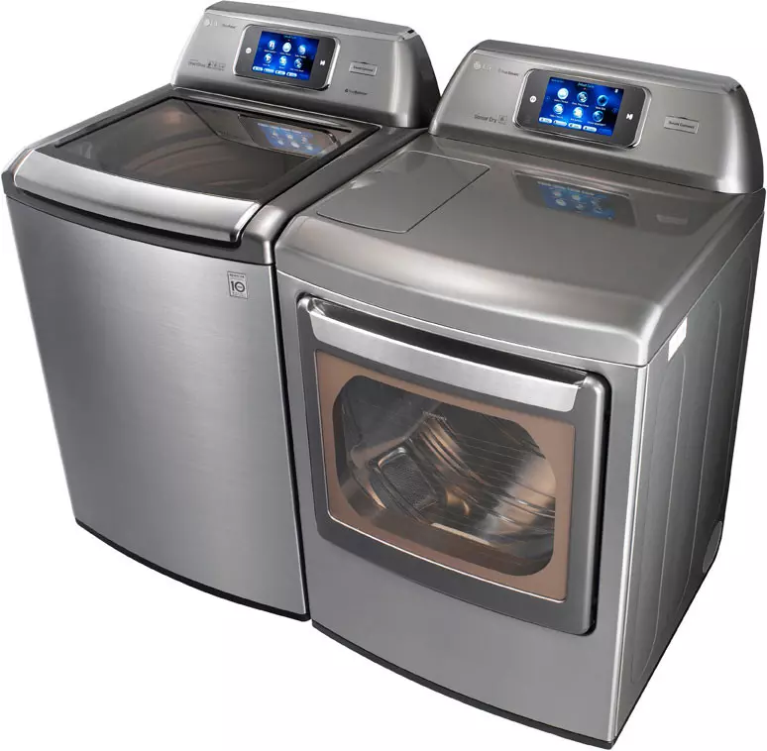
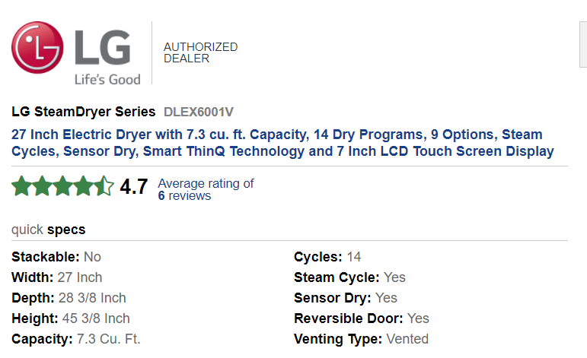
Robot or Not?
Washing Machine
Notes:
🍐 This is a Pear Deck Multiple Choice Slide. Your current options are: A: YES, B: NO,
🍐 To edit the type of question or choices, go back to the "Ask Students a Question" in the Pear Deck sidebar.

Slide 15
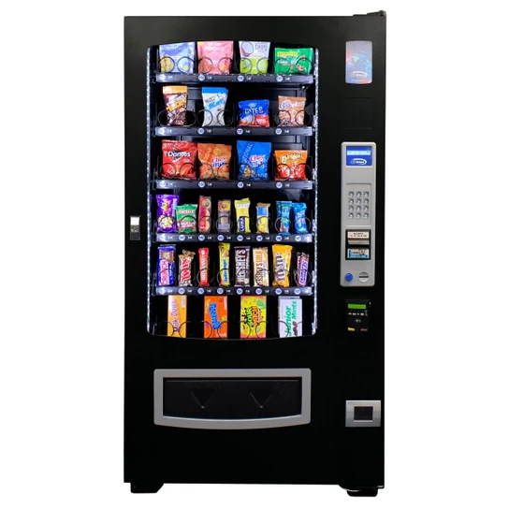
Robot or Not?
Vending Machine
Notes:
🍐 This is a Pear Deck Multiple Choice Slide. Your current options are: A: YES, B: NO,
🍐 To edit the type of question or choices, go back to the "Ask Students a Question" in the Pear Deck sidebar.

Slide 16
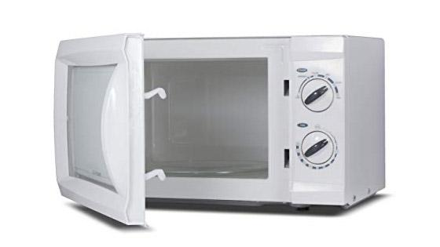
Robot or Not?
Microwave
Notes:
🍐 This is a Pear Deck Multiple Choice Slide. Your current options are: A: YES, B: NO,
🍐 To edit the type of question or choices, go back to the "Ask Students a Question" in the Pear Deck sidebar.

Slide 17
What is a robot?
Rules of a robot:
It must be a machine (made by humans).
It must sense its environment.
It must be programmable (respond to instructions).
It must be capable of carrying out actions automatically.
It can be remotely controlled or controlled from within.

Slide 18
What’s not a robot?
Software “bot” that automates a task but doesn’t control a physical device

Slide 19

Robot or Not? Netflix Recommendation Bot
Rules of a robot:
It must be a machine (made by humans).
It must sense its environment.
It must be programmable (respond to instructions).
It must be capable of carrying out actions automatically.
It can be remotely controlled or controlled from within.
Notes:
🍐 This is a Pear Deck Multiple Choice Slide. Your current options are: A: YES, B: NO,
🍐 To edit the type of question or choices, go back to the "Ask Students a Question" in the Pear Deck sidebar.

Slide 20
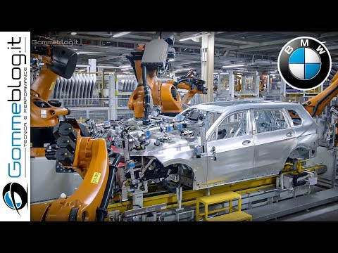
Robot or Not?
Car Assembler
Rules of a robot:
It must be a machine (made by humans).
It must sense its environment.
It must be programmable (respond to instructions).
It must be capable of carrying out actions automatically.
It can be remotely controlled or controlled from within.
Notes:
🍐 This is a Pear Deck Multiple Choice Slide. Your current options are: A: YES, B: NO,
🍐 To edit the type of question or choices, go back to the "Ask Students a Question" in the Pear Deck sidebar.

Slide 21

Robot or Not?
TikTok
Rules of a robot:
It must be a machine (made by humans).
It must sense its environment.
It must be programmable (respond to instructions).
It must be capable of carrying out actions automatically.
It can be remotely controlled or controlled from within.
Notes:
🍐 This is a Pear Deck Multiple Choice Slide. Your current options are: A: YES, B: NO,
🍐 To edit the type of question or choices, go back to the "Ask Students a Question" in the Pear Deck sidebar.

Slide 22
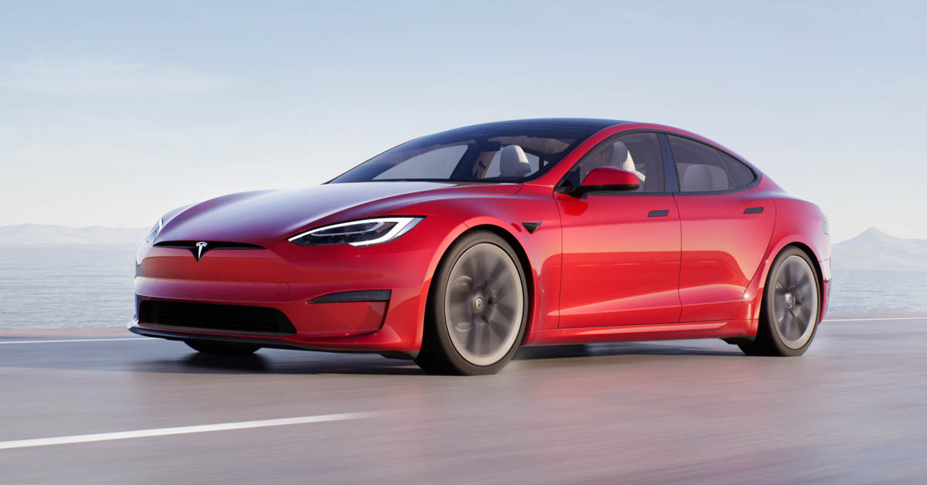
Robot or Not?
Rules of a robot:
It must be a machine (made by humans).
It must sense its environment.
It must be programmable (respond to instructions).
It must be capable of carrying out actions automatically.
It can be remotely controlled or controlled from within.
Notes:
🍐 This is a Pear Deck Multiple Choice Slide. Your current options are: A: YES, B: NO,
🍐 To edit the type of question or choices, go back to the "Ask Students a Question" in the Pear Deck sidebar.

Slide 23
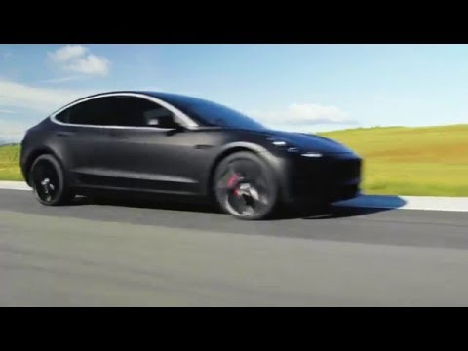
Self-Driving Car
Rules of a robot:
It must be a machine (made by humans).
It must sense its environment.
It must be programmable (respond to instructions).
It must be capable of carrying out actions automatically.
It can be remotely controlled or controlled from within.

Slide 24
DO NOT PASS
Do not pass this slide until we finish discussing what is and what is not a robot.

Slide 25
Robot Videos
All of the machines in the following videos ARE robots. These machines follow all of the rules we learned previously.

Slide 26
New Question:
Do all robots have AI?
An autonomous robot can make decisions about what it will do.
Having “Artificial Intelligence” or AI means that the robot can “perceive” or make meaning of what it senses.

Slide 27
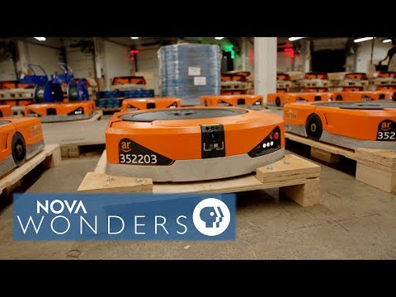
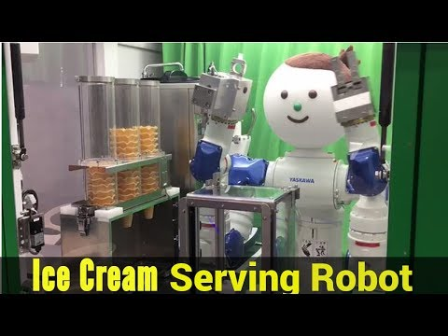
Whole Group Examples
Ice Cream Shop
Kiva Wearhouse
Boston Dynamics
Notes:
Which example would you like to use as a class to Think. Pair. Share (in whole group) about? Choose a video (or more than 1 depending on time) and decide it’s level of autonomy using the chart on the worksheet.

Slide 28

Directions:
With a partner, choose 3 robot videos from the following slides.
On the worksheet, write a short summary of what the robot does.
Then, decide what “level of autonomy” should be assigned to the robot and why.

Slide 29
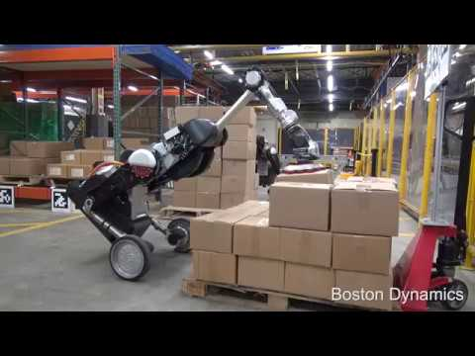
Robot Video #1 - Handle Robot

Slide 30
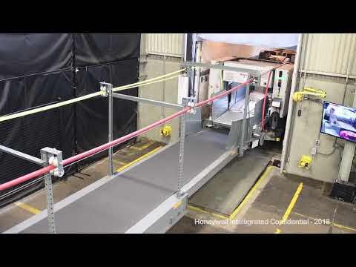
Robot Video #2 - Unloading a Truck

Slide 31
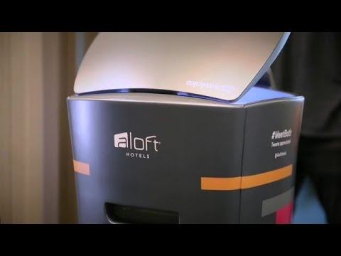
Robot Video #3 - Butler

Slide 32
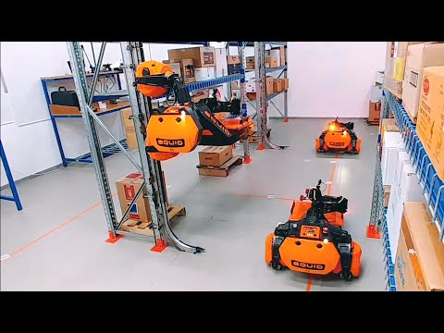
Robot Video #4 - Warehouse Robot

Slide 33
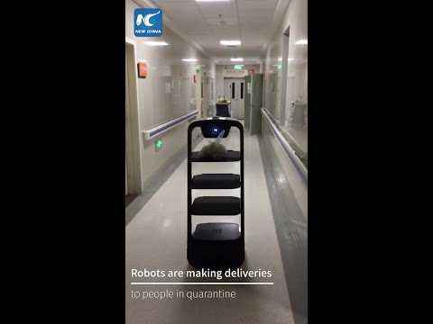
Robot Video #5 - In Hospitals (during COVID)

Slide 34
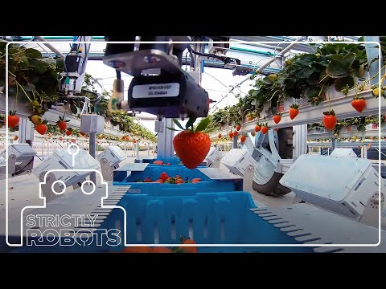
Robot Video #6 - Fruit Picking

Slide 35
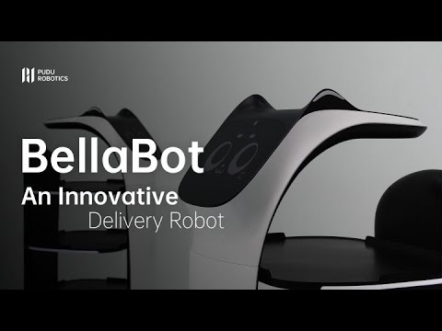
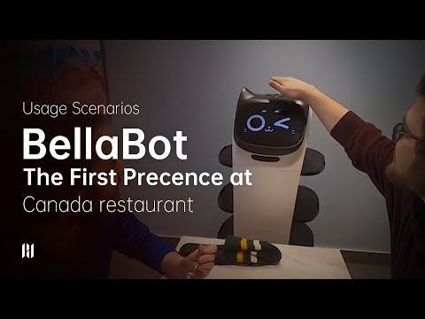
Robot Video #7 - In Restaurants

Slide 36
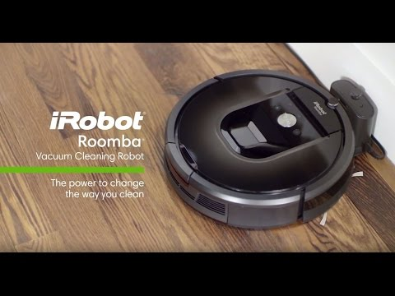
Robot Video #8 - Vacuum

Slide 37
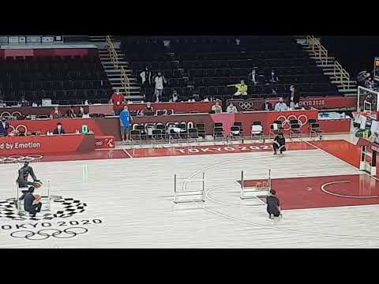
Robot Video #9 - Toyota Basketball Robot

Slide 38
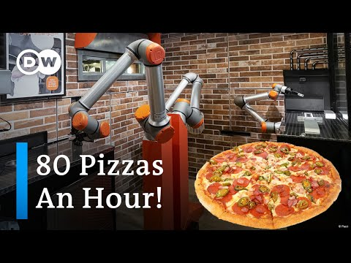
Robot Video #10 - Pizza-Making Robot

Slide 39

Careers in Robotics
Robotics is an interdisciplinary field that draws ideas from electrical engineering, mechanical engineering, and computer science (including artificial intelligence).
Mechanical Engineer
Computer Scientist
Roboticist

Slide 40
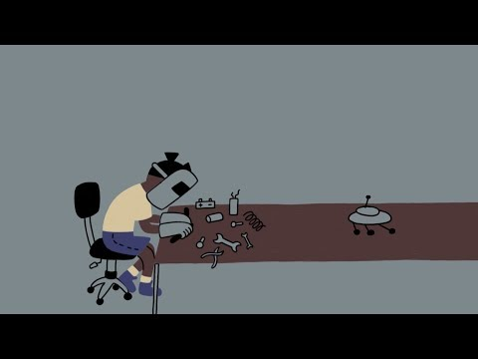
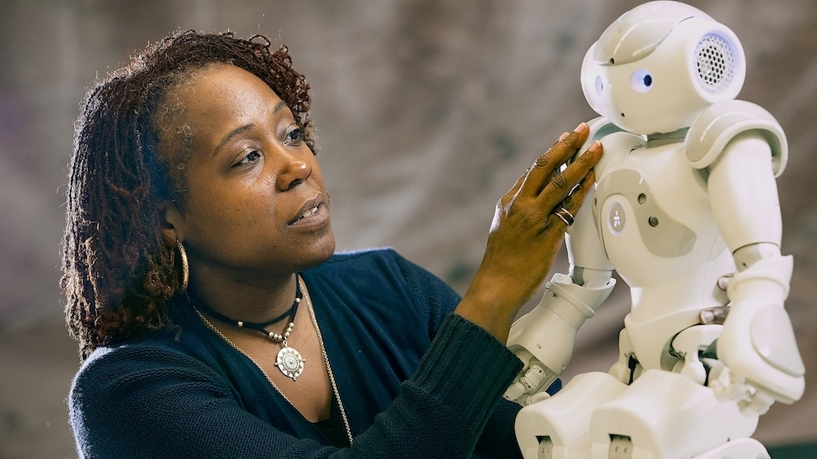
Dr. Ayanna Howard
Roboticist, NASA Engineer, Entrepreneur, Professor, & Dean
Learn more about her journey. Watch & Read, Deeper Read

Slide 41
Varieties of Autonomous Robots
Learn more about robots
Five warehouse robots: https://www.youtube.com/watch?v=9mG1bgs_ND0

Slide 42
My Dream Bot
Over the course of Unit 1, you will design your own dream robot.

Slide 43
Module 1.2 (A): Exit Ticket
Tip: Students should complete in their own Dream Bot slides
If you could have a dream robot, what would that robot do?
Answer
What would you name the robot?
Answer

